Slide 1
COMP 4332 / RMBI 4310 Big Data Mining (Spring 2021)
Project 3 Rating Prediction
TA: Haoran Li (hlibt@connect.ust.hk)

Slide 2
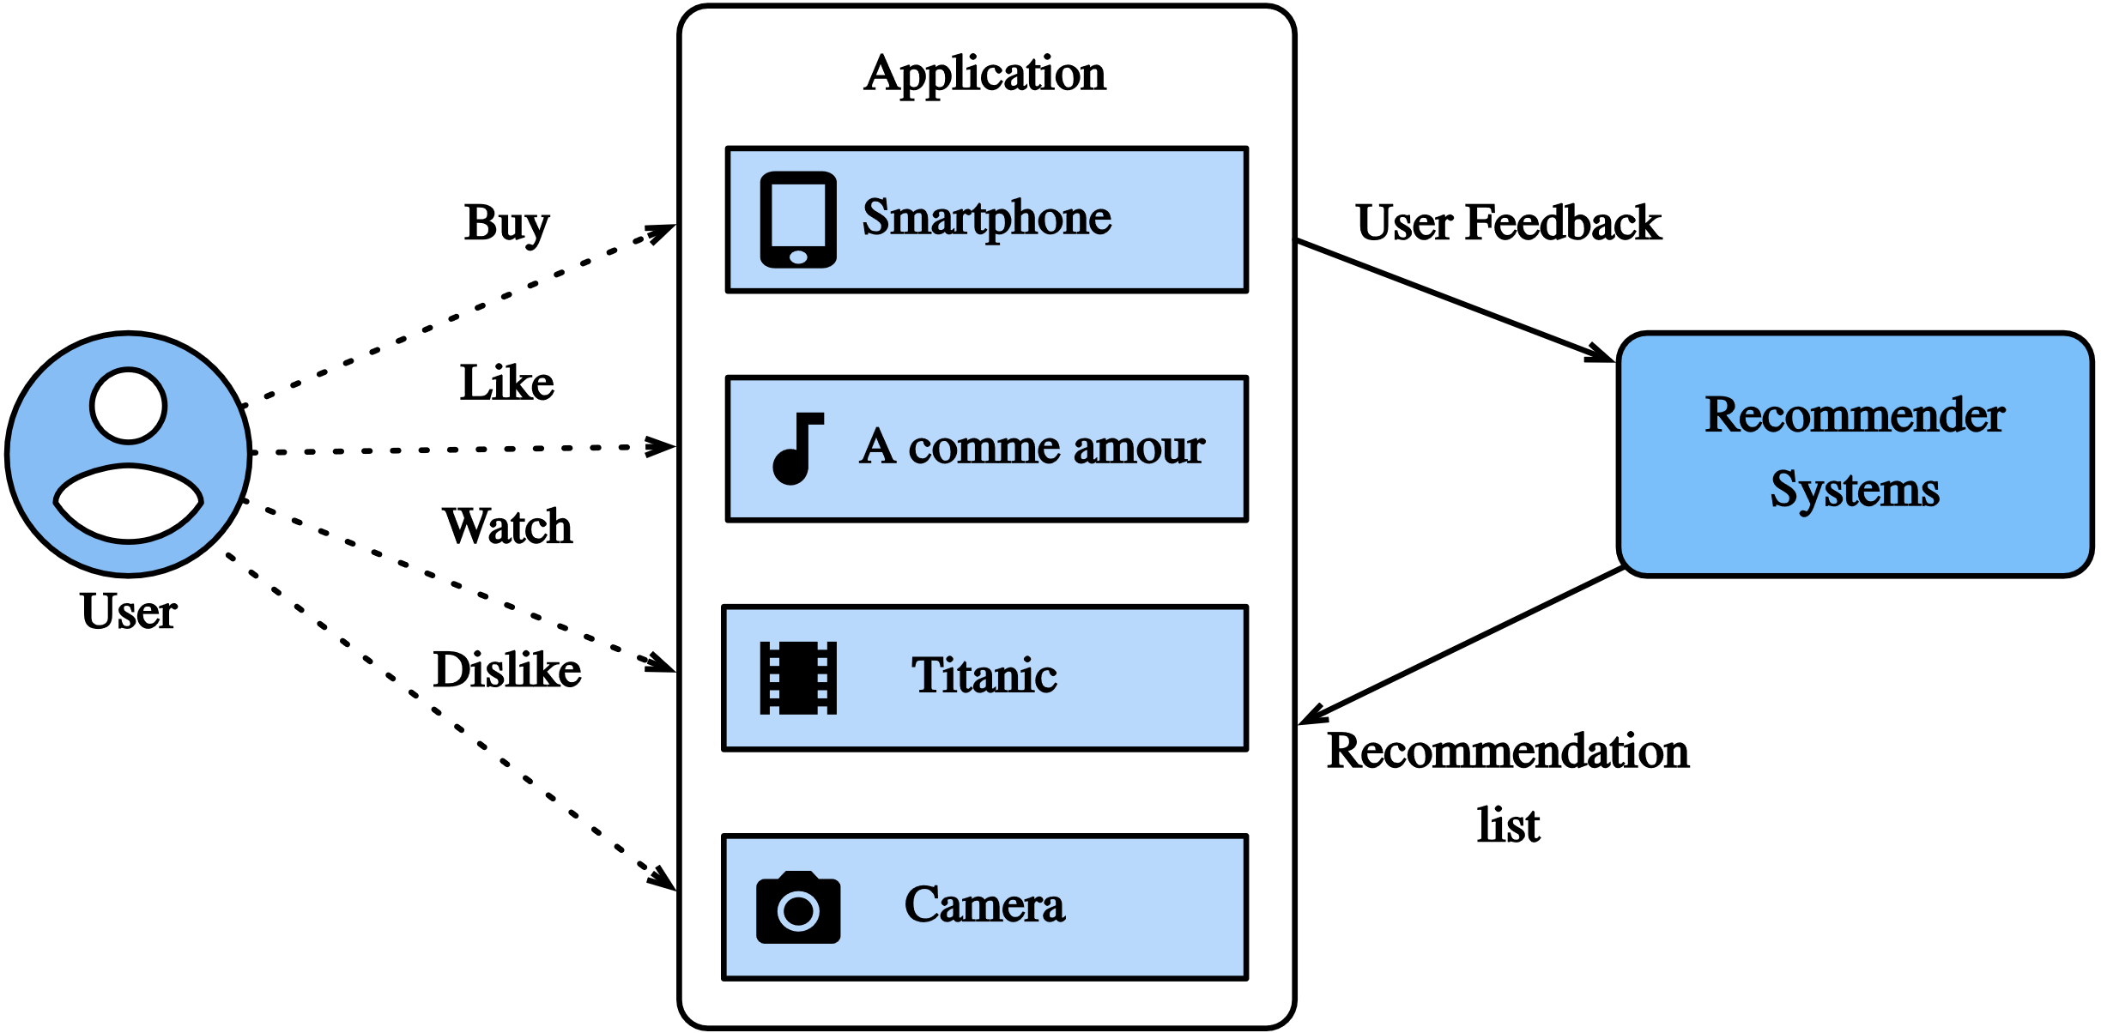
Recommendation Systems

Slide 3
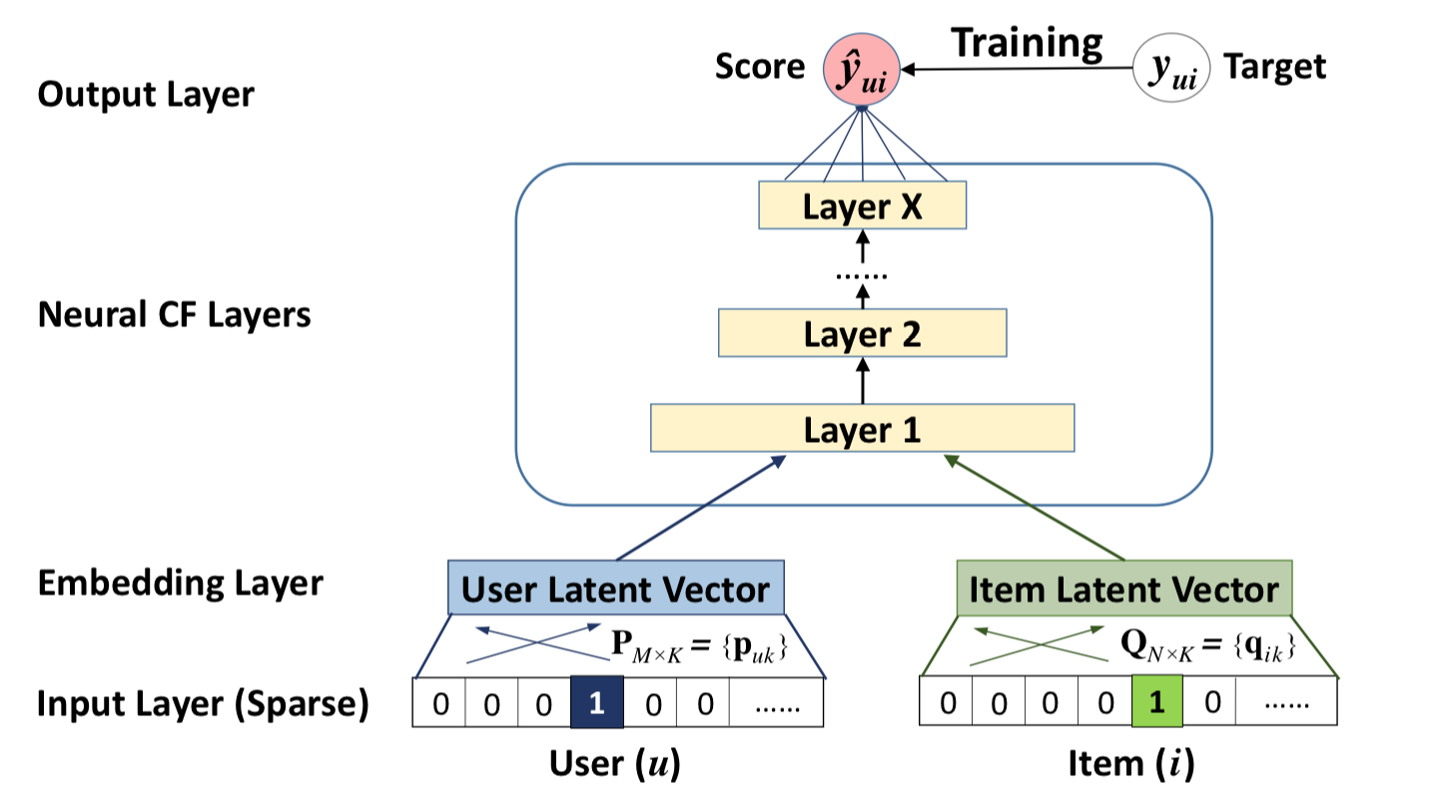
Neural CF
In Tutorial 9
Xiangnan He, Lizi Liao, Hanwang Zhang, Liqiang Nie, Xia Hu and Tat-Seng Chua (2017). Neural Collaborative Filtering. In Proceedings of WWW '17, Perth, Australia, April 03-07, 2017.

Slide 4
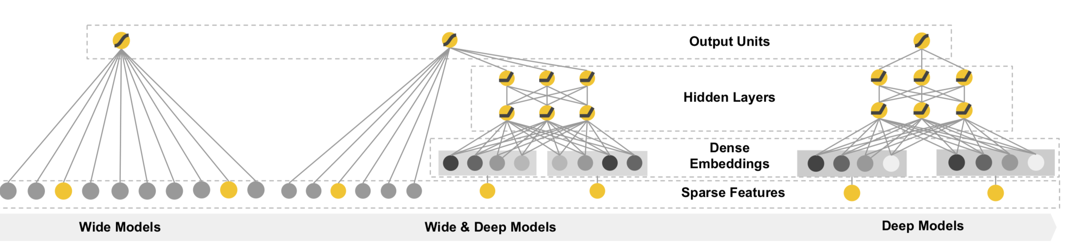
Wide & Deep Learning
In Tutorial 9
Memorization
Generalization
Heng-Tze Cheng,Levent Koc,Jeremiah Harmsen,Tal Shaked,Tushar Chandra, Hrishi Aradhye, Glen Anderson, Greg Corrado, Wei Chai, Mustafa Ispir, et al. 2016. Wide & deep learning for recommender systems. In Proceedings of the 1st Workshop on Deep Learning for Recommender Systems. ACM, 7–10.

Slide 5
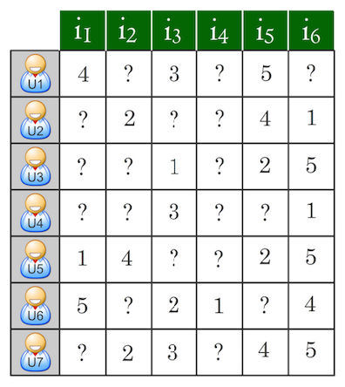
Rating Prediction
Predict users’ ratings on items given some known ratings. The prediction would be evaluated by Root Mean Squared Error (RMSE)

Slide 6
Dataset
User ratings
Extra user information
Extra business information

Slide 7
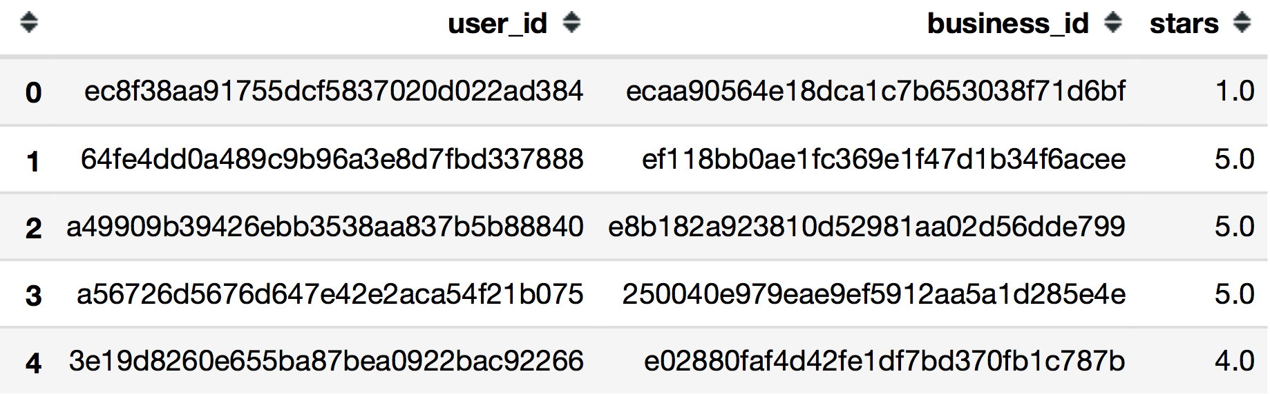
User ratings:

Slide 8
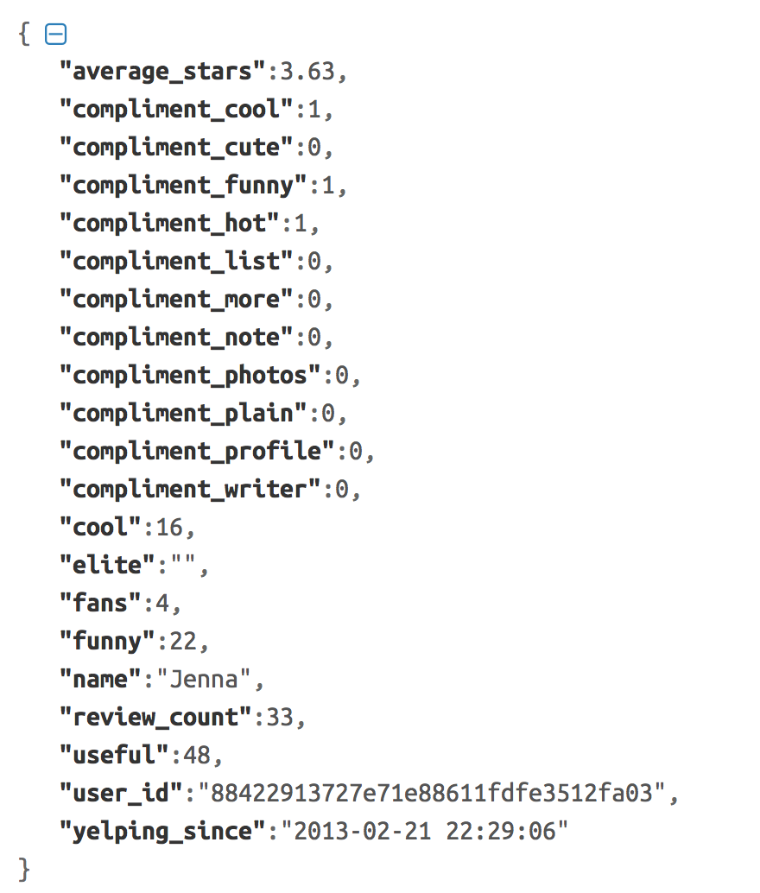
Extra user information
Techniques for using this information through Wide and Deep Learning model will be introduced in tutorial 8

Slide 9
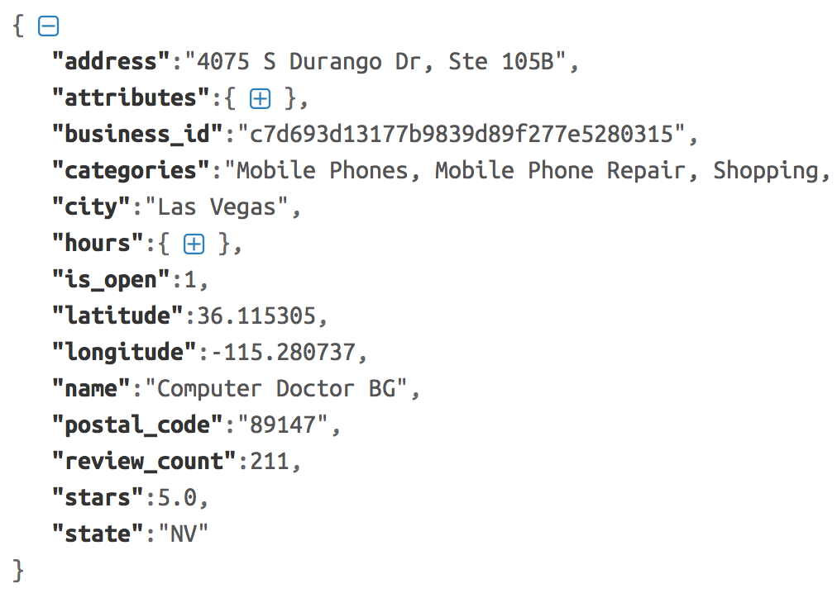
Extra business information
Techniques for using this information through Wide and Deep Learning model are in tutorial 9

Slide 10
We provide:
Rating data (rating scale is 1.0-5.0) :
‘train.csv’ : 60080 ratings
‘valid.csv’ : 7510 ratings
‘test.csv’ : 7510 ratings (entries of ‘stars’ column in ‘test.csv’ are all set to 0.0)
User information :
‘user.csv’: 2980 users
Business information
‘business.csv’: 5964 businesses
Code for evaluating predictions: ‘evaluate.py’

Slide 11
Submission
Predictions on test data (please make sure you can successfully evaluate your validation predictions on the validation data with the help of evaluate.py)
Report (1~2 pages)
Code (Frameworks and even programming languages are not restricted.)
DDL: 11:59 pm, May 20, 2021
Submission:
Each team leader is required to submit the groupNo.zip file that contains pre.csv and your team’s code on canvas.
Each student is required to submit his/her own project report individually (All members in a group can choose to submit the same project report. But the submission still need to be done individually)
we will check your report with your code and the RMSE.

Slide 12
Grading Rule
Grade | Model (80%) | Report (20%) | Baseline (RMSE on validation/test set)
60% |  | submission | 1.066/1.087
80% | an easy baseline that most students can outperform | detailed explanation | 1.030/1.040
90% | a competitive baseline that about half students can surpass | detailed explanation and analysis | 1.020/1.025
100% | a very competitive baseline | excellent visualization and analysis | 1.005/1.020

Slide 13
Other information:
1. You are welcome to use any methods to make the prediction.
2. The methods taught in the class/tutorial (including previous ones) + some parameter tuning + some feature engineering are enough for you to get the full marks.
3. Late submission policy is the same as project 1.
4. Peer evaluation is not required.

Slide 14
Thank You

